Slide 1
Ecofeminism: Actors and Issues
Glyn Rimmington

Slide 2
Outline
What is Ecofeminism?
Ecofeminism & Science
Deep Ecology
Agents
Environmental Issues
DDT
Endangered Species
Forests
Global Crime Networks
Where to now?

Slide 3
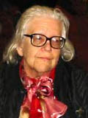
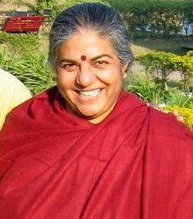
What is it?
Françoise d'Eaubonne (1920 – 2005)
A French feminist writer, who introduced the term ecofeminism in 1974.
Ecofeminism connects exploitation and domination of women with exploitation and domination of the environment.
Vandana Shiva (1952 -)
An Indian environmental activist and author, educated as a quantum theorist in Canada, who resides in Delhi.
Women have a special connection to the environment through their daily interactions with it…

Slide 4
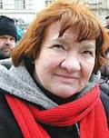
Ecofeminism and Scientific Discourse
Maria Mies (1931 -)
A German Professor of Sociology and feminist writer and author, with Vandana Shiva of Ecofeminism 1993
Argue that modern scientific discourse as a projection of Western male values:
Medicalization of Childbirth, displaces the midwife
Industrialization of Plant Reproduction, makes the cycle of life technologically dependent e.g. terminator gene
Patriarchal Dominance (PD) relies on reinforcement of binary opposites (e.g. culture/nature) through religious and scientific constructs and therefore marginalizing dialectic thinking

Slide 5
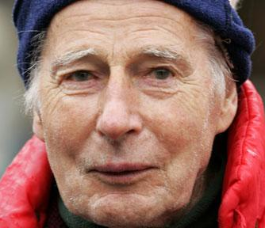
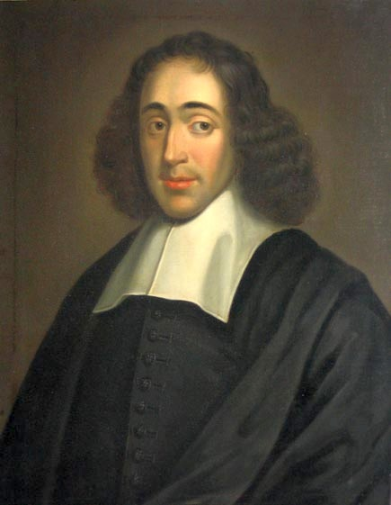
Deep Ecology
Coined by Norwegian philosopher, Arne Naess 1973; The shallow and the deep, long-range ecology movement
Roots: Baruch Spinoza, Jewish-Dutch, Quintessential Philosopher
Examines deeply the actual reality of humanity’s relationship with natural world;
Anti-thesis of anthropocentrism, consumerism, industrialism, and materialism
Advocacy of the inherent worth of the biotic and abiotic, regardless of their instrumental utility to human needs
Complex inter-relationships in which organisms depend on each other
Fosters ethics of: preservation; human population control; reduced footprint
Arne Naess
(1912 – 2009)
Baruch Spinoza
(1632 - 1677)

Slide 6
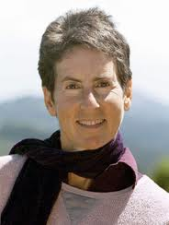
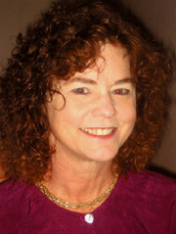
Ecofeminist Response
Marti Kheel — Vegan Ecofeminist, Animal Rights advocate — Nature Ethics: An Ecofeminist Perspective 2007 — UC Berkeley Professor
Too much emphasis on the whole at expense of individual being
Karen J Warren — Philosophy Professor — Ecofeminist philosophy: A Western perspective on what it is and why it matters 2000
Domination of women tethered conceptually and historically to domination of environment
Embraces interconnectedness of living world
Anti-racism, -speciesism, -sexism
Anthropocentrism based on flawed and outmoded value structure
Marti Kheel
(1948 – 2011)
Karen J Warren
(1947 – )

Slide 7
Econfeminist Agents
Conscientization – Sharon Beder
Silent Spring – Rachel Carson
Leakey's Angels – Dian Fossey, Jane Goodall, Biruté Galdikas
Canopy Women – Julia Butterfly-Hill, Meg Loman, Nalini Nadkarni
Food – Ellen Gustafson, Carolyn Steel, Ann Cooper, Louise Fresco
Environmental Terrorism – Loretta Napoleoni
Sex Slavery & Trafficking – Lisa Kristine, Sunitha Krishnan
Bioweapons – Pardis Sabeti, Jeanne Guillemin

Slide 8
Environmental Issues
Pesticides, Bioaccumulation, Extinction, Health Issues, Resistance
Endangered Species, Poaching, Illicit Global Trade, CITES
Forests, Oxygen, Carbon Sequestration, Hydrology, Microclimate
Food Safety, GMO, Growth Hormones, Antibiotics, Animal Rights
Environmental Terrorism, Dumping, Conflict Resources, Poaching
Sex Slavery & Trafficking, Global Crime, Money Laundering
Bioweapons, Genomics, HGT, Synthetic Bacteria, Delivery

Slide 9
DDT
Pesticide

Slide 10
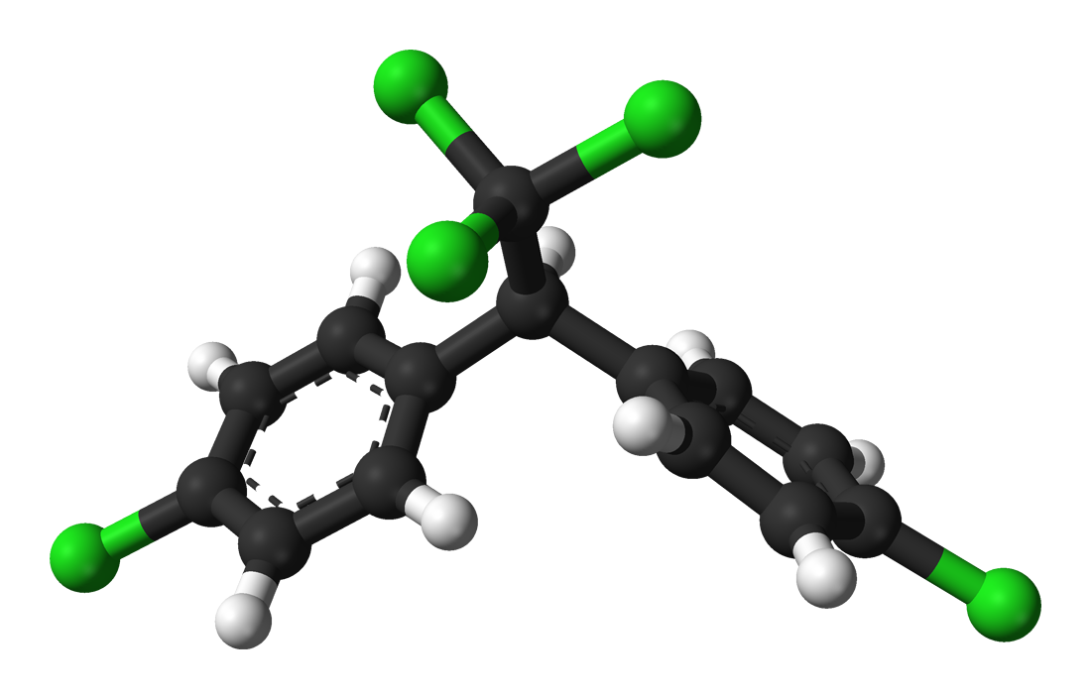
The Molecule that caused people to focus on the effects of artificial chemicals…

Slide 11
The Molecule that caused people to focus on the effects of artificial chemicals…
DDT Dichloro-Diphenyl-Trichloroethane C_{l4}H₉Cl₅
2
2
3

Slide 12
DDT
First synthesized in 1874 by Othmar Zeidler, supervised by Adolf von Baeyer
Patented in 1934
Effects on arthropods discovered by Swiss chemist, Paul Hermann Müller in 1939
Müller won the Nobel Prize in Medicine in 1948
Hydrophobic (repelled by water)
Lipophilic (attracted to fats and oils)
From 1940s scientists concerned about effects of DDT on wildlife and humans
Used to kill Mosquitoes in 1940s and 1950s to eradicate Malaria
Resistant insect species emerged from the mid-1950s
1960s, Falcon/Eagle/Condor populations threatened
Silent Spring published by Rachel Carson in 1962
Banned in US by 1973
2004 Stockholm Convention and (almost) Worldwide ban
Mechanisms:
Interaction with membranes (lipophilic)
Interference with ion exchange

Slide 13
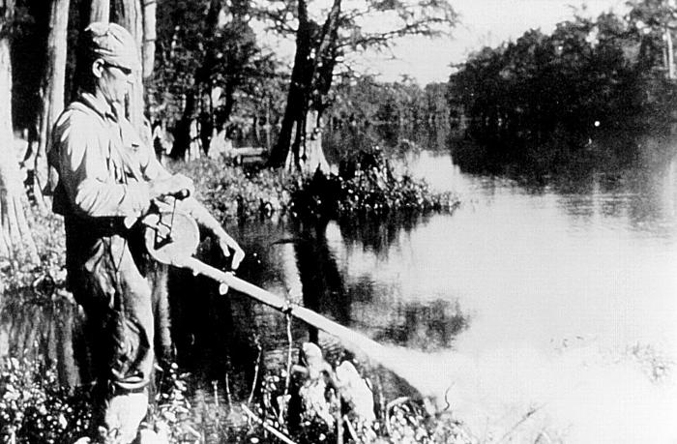
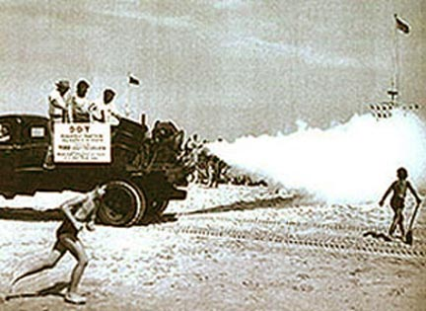
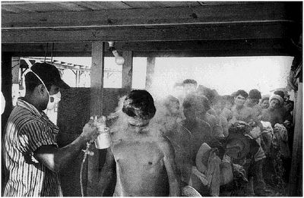
1947
What do we do with all these wartime chemicals now the war is over?
Convince the government that they are the solution to everything.

Slide 14
SO SAFE YOU CAN EAT IT

Slide 15
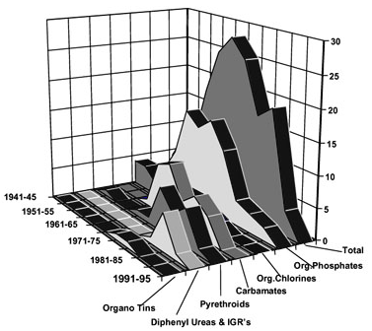
PESTICIDES
TYPES
within
GROUPS
YEAR
GROUPS

Slide 16
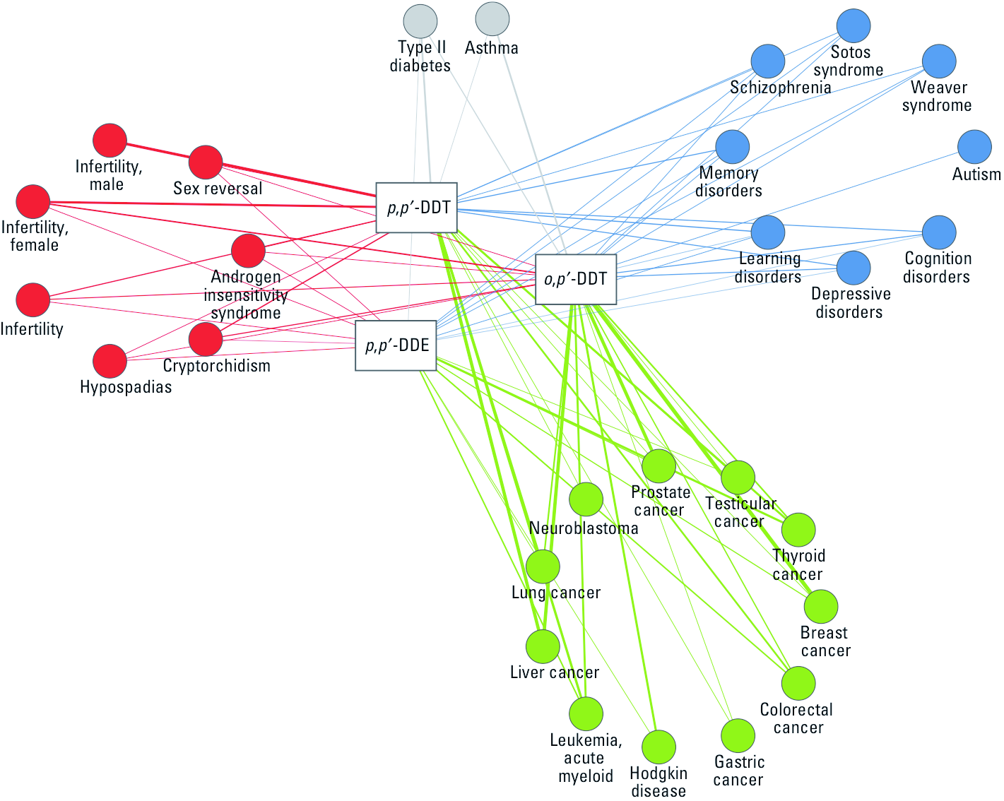
Effects of DDT
NEUROLOGICAL
REPRODUCTION
CANCER

Slide 17
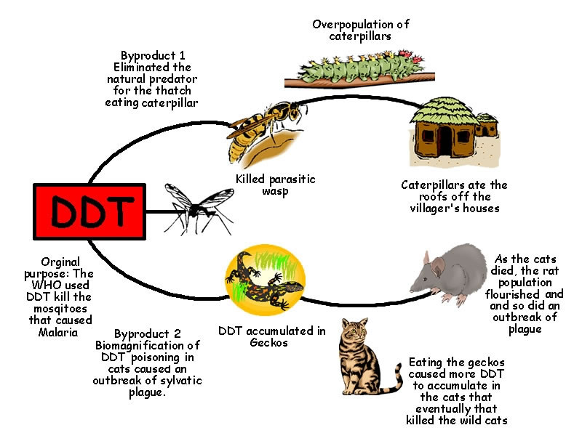
UNINTENDED EFFECTS in BORNEO in 1950s

Slide 18
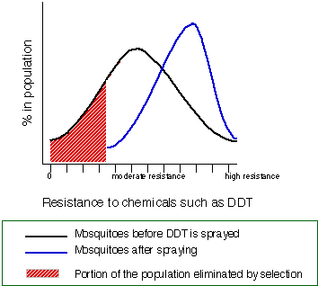
EVOLUTION AT WORK (EVEN IN KANSAS)

Slide 19
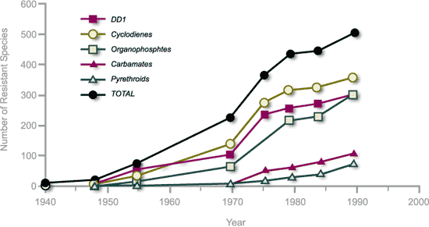
RISE of RESISTANCE

Slide 20
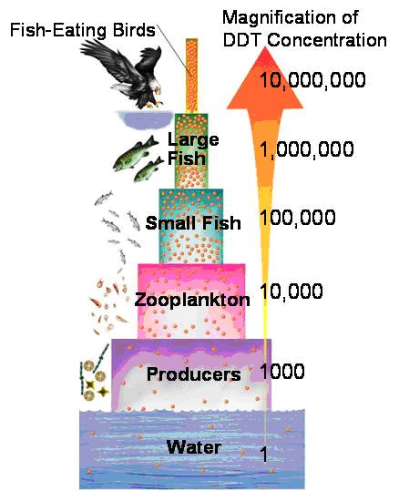

Slide 21
Rachel Carson

Slide 22
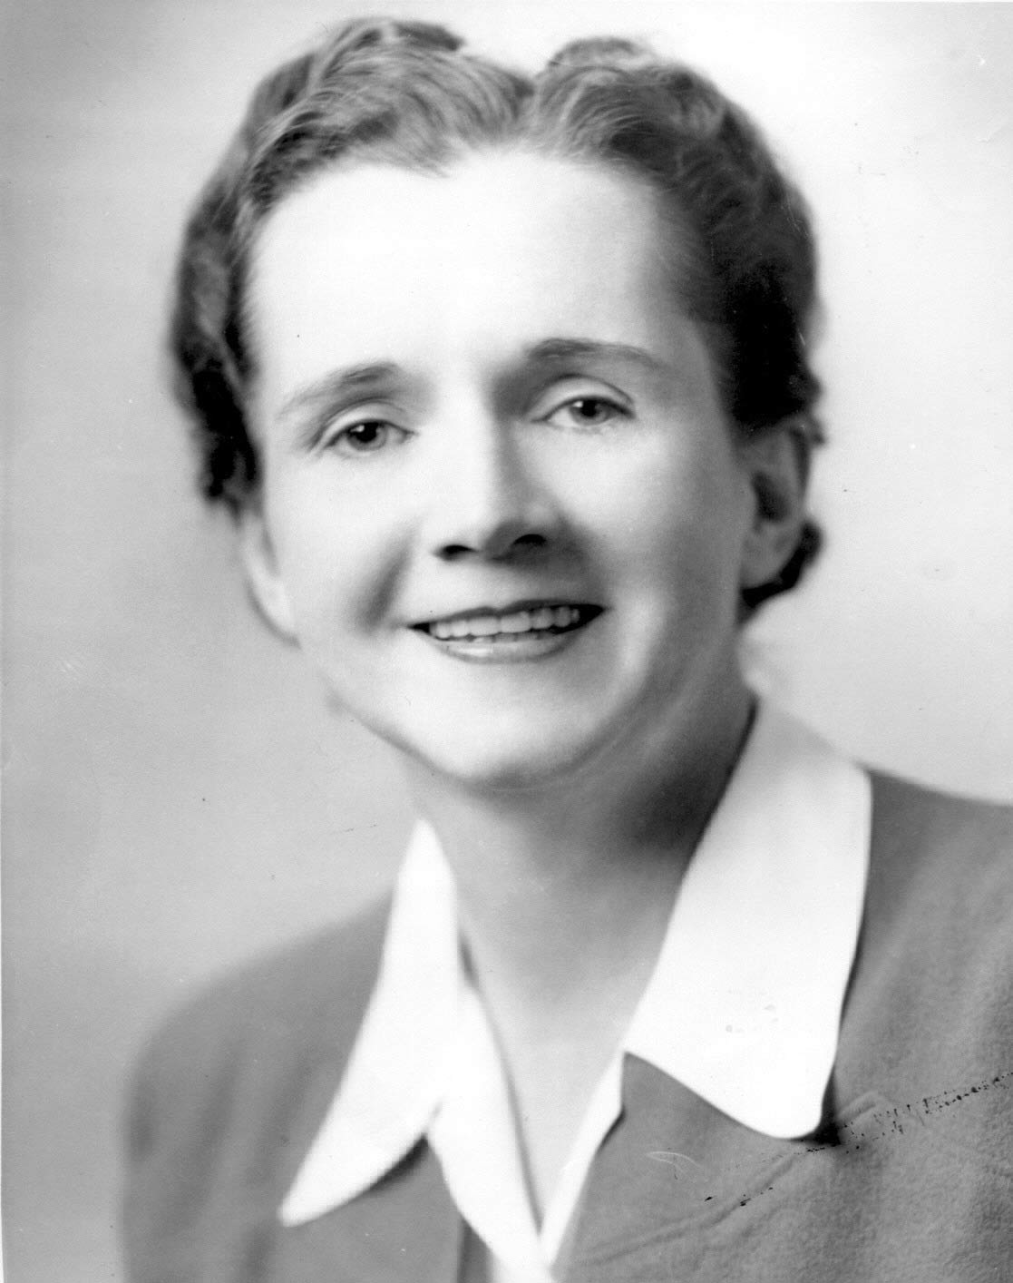
President John F Kennedy - Inquiry into effects of pesticides 1962
President Richard Nixon – Formation of EPA1970, Clean Air Act 1970
EPA bans DDT 1972, Clean Water Act 1972
Olin Corp. pays for DDT Damage 1983
Opposition:
MONSANTO, VELSICOL, AMERICAN CYANAMID, CATO INSTITUTE, USDA, COMPETITIVE ENTERPRISES INSTITUTE, REASON MAGAZINE, HUMAN EVENTS WEEKLY, SPIKED MAGAZINE, G.W. BUSH ADMINISTRATION

Slide 23
Subversive!
Disinformation!
Unqualified!
Communist!
Hysterical Woman!
Fraud!
Job Killer!
Genocide!
Danger to American Way of Life!

Slide 24
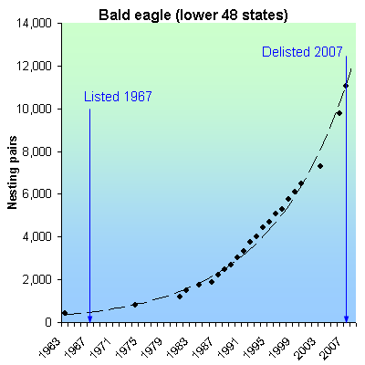
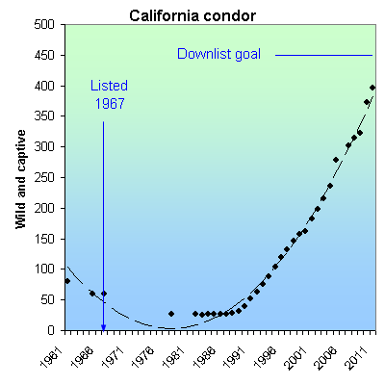
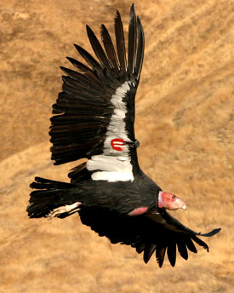
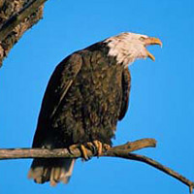

Slide 25
Endangered Species

Slide 26
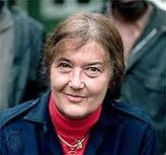
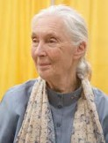
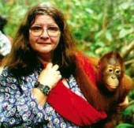
Endangered Species, Poaching, Smuggling Habitat, Manliness, Aphrodisiacs
Dian Fossey
(1932 – 1985 murdered)
Mountain Gorillas
Jane Goodall
(1938 - )
Chimpanzees
Biruté Galdikas
(1946 - )
Orangutan

Slide 27
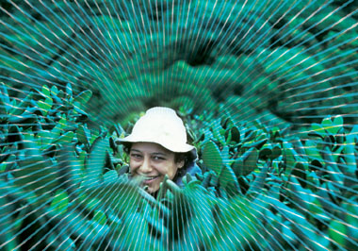
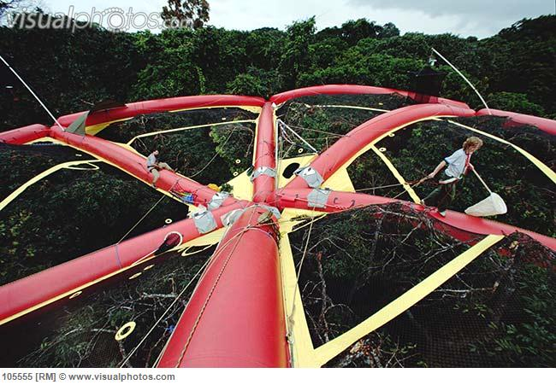
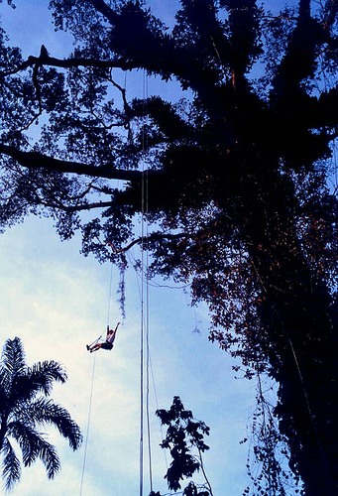
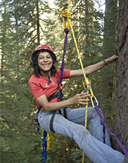
Canopy Women: Forests, Oxygen, Carbon, Hydrology, Erosion, Ecosystems, Biodiversity
Canopy Meg Lowman
(1953 - )
Nalini Nadkarni
(1954 - )
Julia Butterfly-Hill
(1974 - )

Slide 28
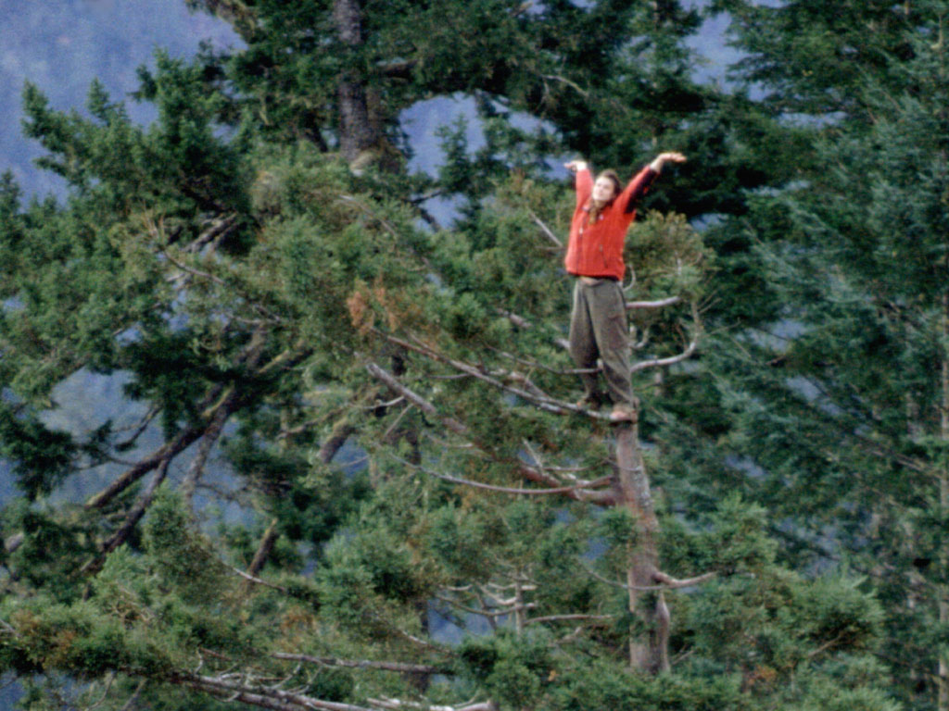
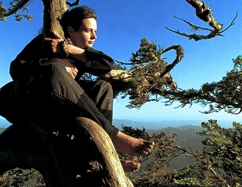
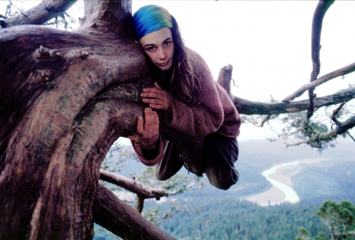
Julia Butterfly-Hill (1974 - )
Lived for 738 days atop a 180 foot tall, 1,500 year old California Redwood, named “Luna”
On 2 6’x6’ platforms
Dec 10, 1997 – Dec 18, 1999
Freezing rain, 64 kmph winds, Helicopter harassment, 10-day seige, intimidation by loggers
Raise $50,000, saved 200’ radius area, donated to Humboldt State University

Slide 29
Sharon Beder
Conscientization

Slide 30
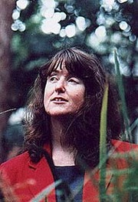
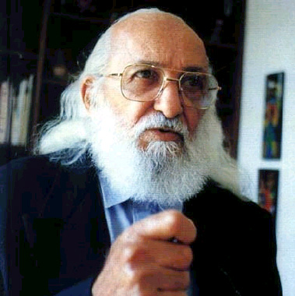
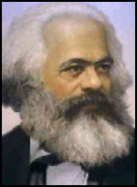
This Little Kiddy Went to Market:
The Corporate Capture of Childhood 2009
Environmental Principles and Policies, 2006
Suiting Themselves:
How Corporations Drive the Global Agenda, 2006
Free-Market Missionaries: The Corporate
Manipulation of Community Values, 2006
Power Play: The Fight For Control of the World’s
Electricity, 2003
Selling The Work Ethic:
From Puritan Pulpit to Corporate PR, 2000
The New Engineer: Management and Professional
Responsibility in a Changing World, 1998
Toxic Fish & Sewer Surfing, 1998
Global Spin: The Corporate Assault on
Environmentalism, 1997
The Nature of Sustainability, 1996
Sharon Beder
Professor
Wollongong University
Paulo Friere
Conscientization
Karl Marx
Critical Social Theory

Slide 31
Global Crime Networks
Women & Environment

Slide 33
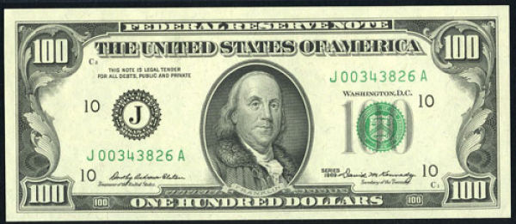
Benjamin Franklin
156mm long x 66mm wide x 0.11mm thick and weighs 1g
(6.14”long x 2.6”wide x 0.04”thick and weighs 0.04oz)
$1 million = 10,000 x $100 bills weighs 10kg (22lb)
6 stacks 20cm (7.9”) high requires suitcase 20x47x13cm or 134cm
(8”x 19” x 5.25” or 54”)
United Economy Class Luggage 23kg (50.75lb) 158cm (62.25”)
Maximum $10,000
99 x $100 bills 1.1cm (.4”) thick and weighs 99g (3.5oz)

Slide 34
Benjamin Franklin
SEIGNIORAGE
Reserve currency of the world
US Government can borrow against all the money in the world
Other governments can only borrow against money within the country
US currency circulates outside the country
US has borrowed against the growth of terrorism and global crime
Ideal currency for laundering
The Federal Reserve prints $1b at a cost of $75,000 giving a profit of $.999925b or $999.925m or 1,333,233%, assuming 7.5c/bill

Slide 35
Laundering 101
Under the Radar – take $9,999 instead of $10,000, repeat 101 times
Smuggling – hide 10,000 $100 bills in an ancient artifact
Blended Dollar – mix in with cash from parking garage, strip club, tanning salon
Sneaky Trading – over- or under-value invoices to conceal extra money
Shell Companies – complex structure to obscure real ownership in different jurisdictions
Off-Shore Banking – move between local and off-shore branches or related banks in jurisdiction with lax laws and no tax
Generous FDI – deposit money into foreign corporation in which you have a controlling interest, in low-tax country and move back as Foreign Direct Investment

Slide 36
Laundering 102
Personal Bank – buy controlling interest in bank with lax controls and move money through your bank
Lucky Casino – Buy chips, gamble some, cash the rest and get a check to claim as winnings
Real Estate – using stand-over tactics buy a property for vastly less than market value, sell and keep proceeds as legitimate income
In-Trust Salaries – pay salaries to unregistered employees without a contract for hazardous jobs and delay payment, keeping it in “trust” until death, then dissolve the trust
Loan Scheme – loan yourself legitimate money from bank in which you have a controlling interest and pay back with illegal money

Slide 37
G_{L}OB^{A}L _{C}R_{I}^{M}E NE^{T}WO_{R}KS

Slide 38
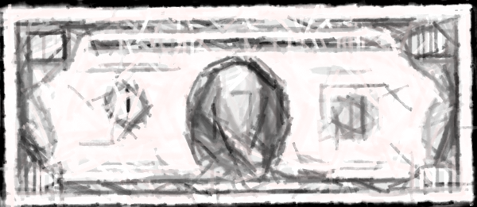
Global Crime Network Design Basics
SLAVES
DRUGS
ORGANS
ANIMALS
PARTS
CONFLICT
GEMS
SEX
LUMBER
POLITICIANS
BANKS
ARMY
WEAPONS
MANSIONS
SPORTS CARS
ISLANDS
COUNTRIES
YACHTS

Slide 39
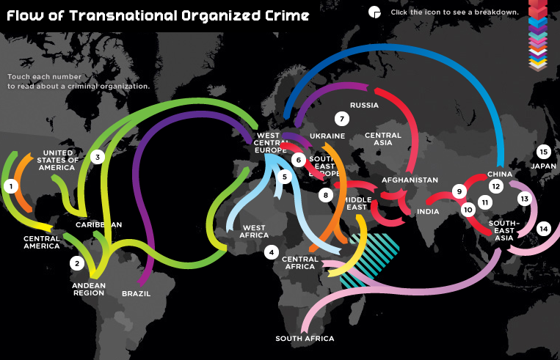

Slide 40
What did we learn?
Those in power use their power to stay in power
Effort will always be needed to maintain Women’s Rights
Corollary: Don’t take past achievements for granted
Effort will always be needed to maintain Protection of the Environment
Corollary: Don’t take past achievements for granted
To be continued…

Slide 42
Questions?

