Slide 2
OUR MISSION
To promote peace through mutual respect, understanding and cooperation –
one individual,
one community at a time.

Slide 3
CURRENT SISTER CITIES
Orleans, France - August 16, 1944 (unofficial), 1974 (through Sister Cities International)
Tlalnepantla, Mexico - October 16, 1973
Cancun, Mexico - November 25, 1975
Kaifeng, China - December 3, 1985

Slide 4
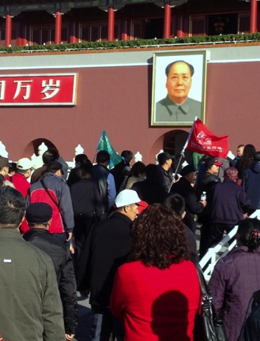
Wichita Area Sister Cities, Inc.

Slide 5
WICHITA AREA SISTER CITIES, INC. BYLAWS (excepts)
Purposes
2.3 Specific Purposes:
To establish and maintain an association of persons, interested in encouraging goodwill and cooperation between the citizens of Wichita, Kansas, and its Sister Cities;
To solicit funds and materials to achieve this end;
To receive gifts and property for this purpose;
To promote exchanges of all types;
To advise the Mayor and/or City Council regarding Sister Cities activities and cultural matters.
Powers
3.3.No Political Activities: No substantial part of the activities of the corporation shall be the carrying on of propaganda, or otherwise attempting to influence legislation. The corporation shall not participate in, or intervene in (including the publishing or distribution of statements) any political campaign on behalf of any candidate for public office.

Slide 6
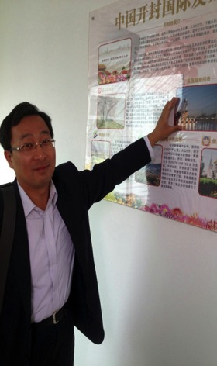

Slide 7
Wichita - Kaifeng
Kaifeng, Henan Province
First editorial appeared in Wichita Beacon on February 7, 1979
October 12, 1984: Lt. Governor Dockings on the invitation of the WASC Board and Mayor Knight attended the WASC Board meeting and advised it to establish Sister Cities relationship with Kaifeng

Slide 8
Wichita - Kaifeng
The Task Force included 14 people:
Lt. Governor Tom Docking
Dr. Dae H. Chang Wichita Asian Association
Leon Trammel – Community-at-large
Richard Minkler - Friends of Sister Cities, Inc.
Jerry Marlot – Wichita Area Chamber of Commerce
Garry Sherrer – Wichita Convention and Visitor’s Bureau
Bill Cozine – Wichita Sister Cities Advisory Board
Dr. Lew Purington - Wichita Sister Cities Advisory Board
Jack Jones – Wichita Public School System
Rosalie Summers – The Friendship Force
Mayor Robert Knight
Jan Siefkes – Community-at-large
Bob Langenwalter – Community-at-large
Dr. Clark Ahlberg – Community-at-large

Slide 9
Wichita - Kaifeng
Task Force committees were set up on December 5, 1984:
Explore Trade and Commerce potential
Robert Langenwalter, Gary Sherrer, Rosalie Summers and Leon Trammel
Educational and cultural/People to People
Jack Jones, Dr. Dae H. Chang, Richard Minkler, Dr. Lew Purinton, Jan Siefkes and Rosalie Summers
Sources of Finance
Jerry Mallot
William Cozine
Lt. Governor Tom Docking
Mayor Robert Knight

Slide 10
Wichita - Kaifeng
In spring of 1985, a delegation from Kaifeng visited Wichita
The Eagle Beacon published the following articles:
Chinese Communists on Tour of Kansas
Girl Scots Catch Eyes of Chinese
Chinese Visitors Mean Business for Kansas
Wichita Oriented Towards Getting Chinese

Slide 11
Wichita - Kaifeng
In 1985, the Wichita City Council voted to extend invitation to Kaifeng , Hanan Province of the People’s Republic of China, to become its Sister City
Lt. Governor Thomas Docking made a formal presentation in the Chinese Embassy in Washington, D.C.

Slide 12
Wichita - Kaifeng
Summer 1985: 20 teachers from Kansas visited the Henan province
November 1985: Mayor Robert Brown invited Mayor Zhu to visit Wichita
December, 1985: Wichita Mayor Robert Brown and Kaifeng Mayor Zhu Zhencheng signed agreement with the emphasis on trade development

Slide 13
Wichita - Kaifeng
The Eagle Beacon published the following articles:
Wichita Links Up with Kaifeng
Chinese Representatives Visit University Campus
First Official Visit of Wichitans to Kaifeng
Chinese Delegation to Visit Wichita April 27-May 1, 1988
Knight cancels Trip to Kaifeng, China
Three Months in China: Anthropologists Study National Minorities

Slide 14
Wichita - Kaifeng
1990: Visit of Kaifeng delegation to Wichita November 18-21, 1990
1992: Kaifeng and Orleans delegation arrived to Wichita
1994: Kaifeng People’s Association for Friendship with Foreign Countries visited Wichita
1996: Official delegation from Kaifeng
2000 – Kaifeng official delegation comes to Wichita
2000 – Wichita delegation goes to Henan U. to participate in table tennis tournament
2012 – The Mayor’s delegation goes to China. It included businessmen and four representatives of WASC: Dr. Thomas and Mrs. Rosenberg, Mr. Marty Miller and Dr. Valentina Chappell
2013 – Wichita Aviation Office of China was opened in Beijing
Notes:
Support of Friends of Sister Cities, Inc. P.O. Box 47242 Wichita, KS 67201

Slide 15
Official Delegation to China October 2012

Slide 16
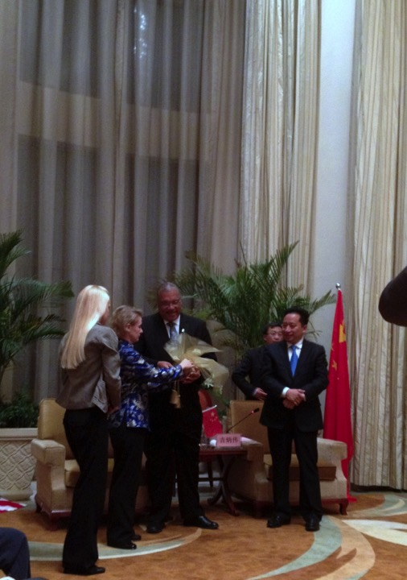
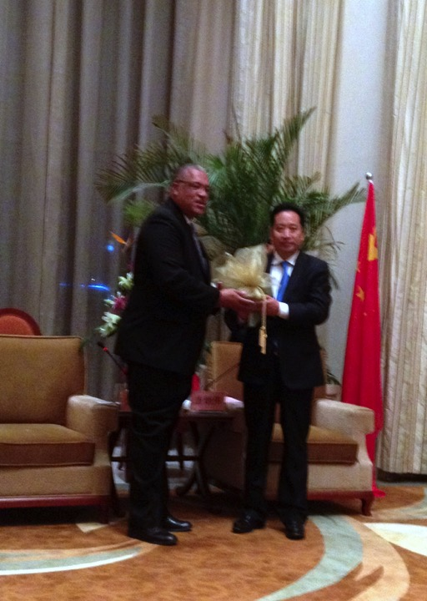
Official Delegation to China October 2012

Slide 17
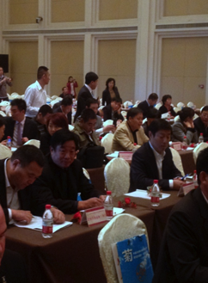
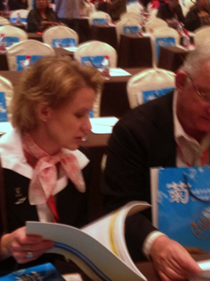
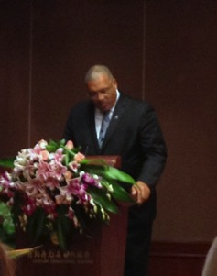
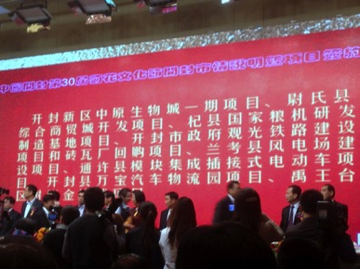
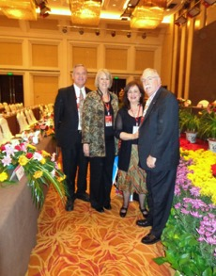
Official Delegation to China October 2012

Slide 18
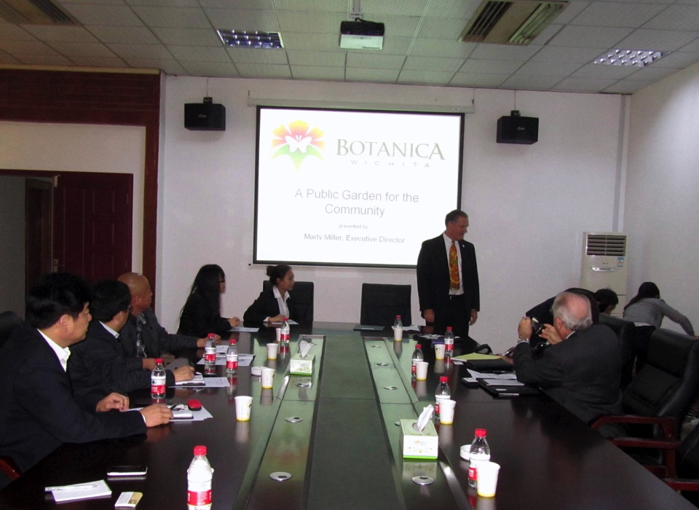

Slide 19
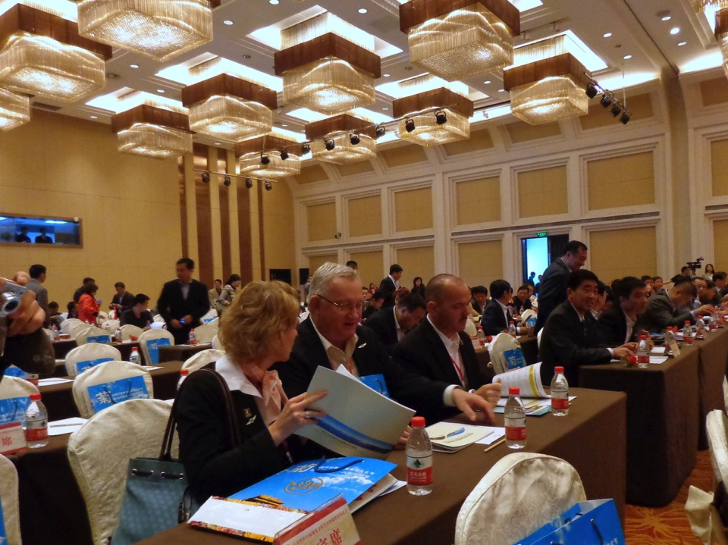

Slide 20
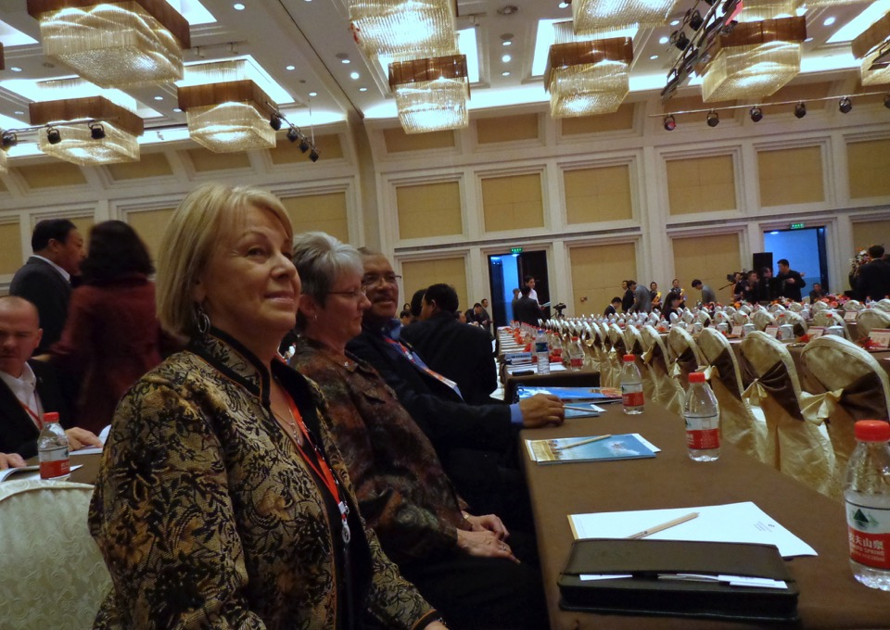

Slide 21
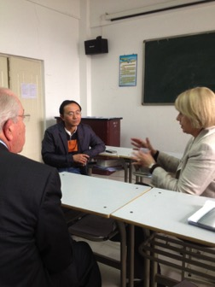
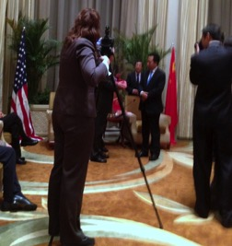
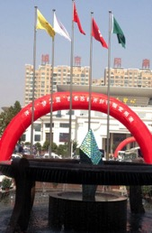
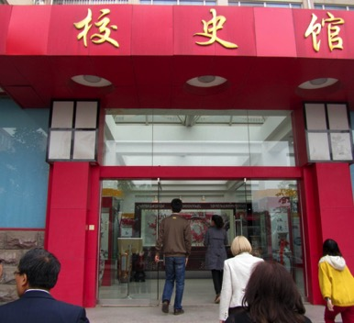
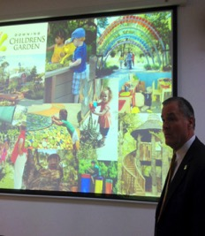
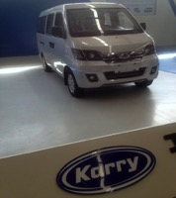
Official Delegation to China October 2012

Slide 22
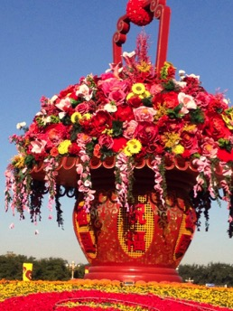
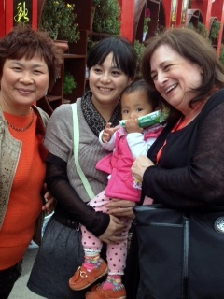
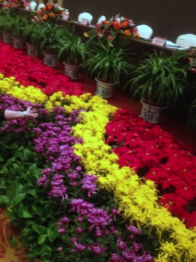
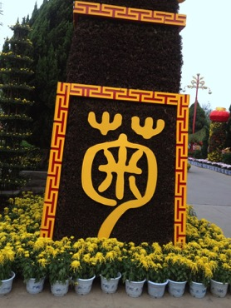
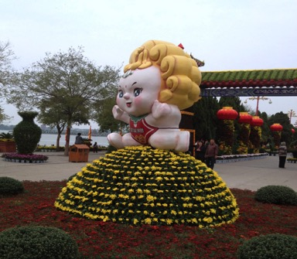
30th Chrysanthemum Festival Kaifeng, China

Slide 23
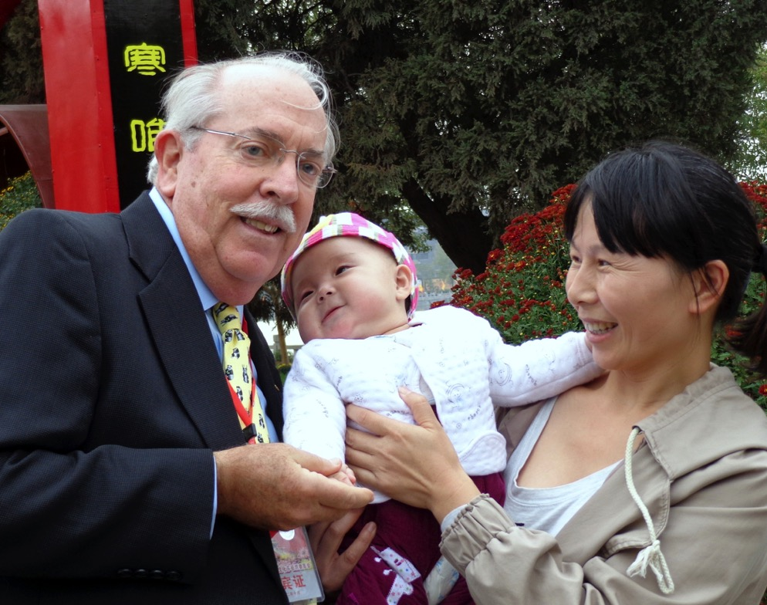

Slide 24
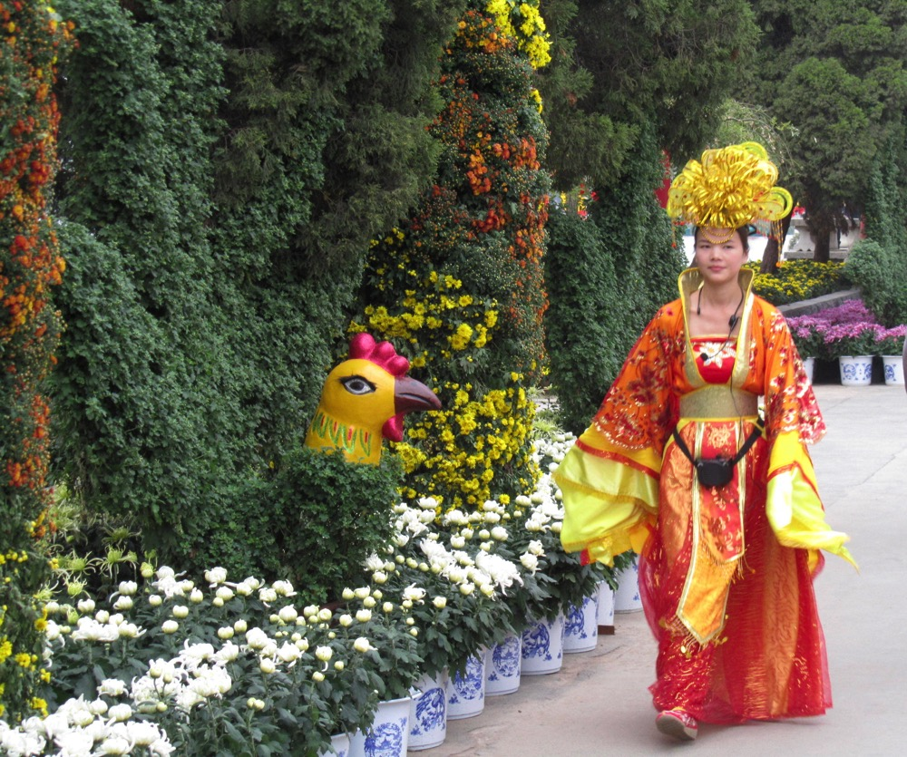
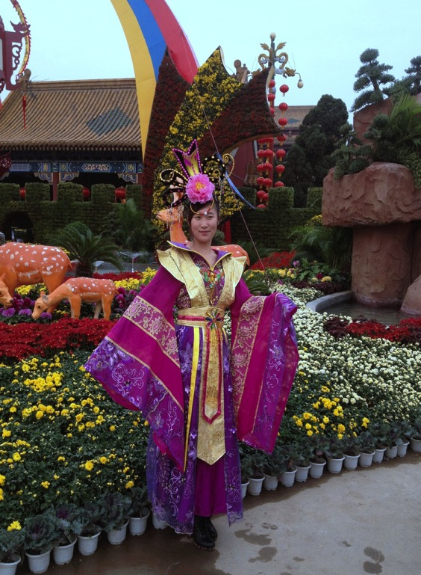

Slide 25
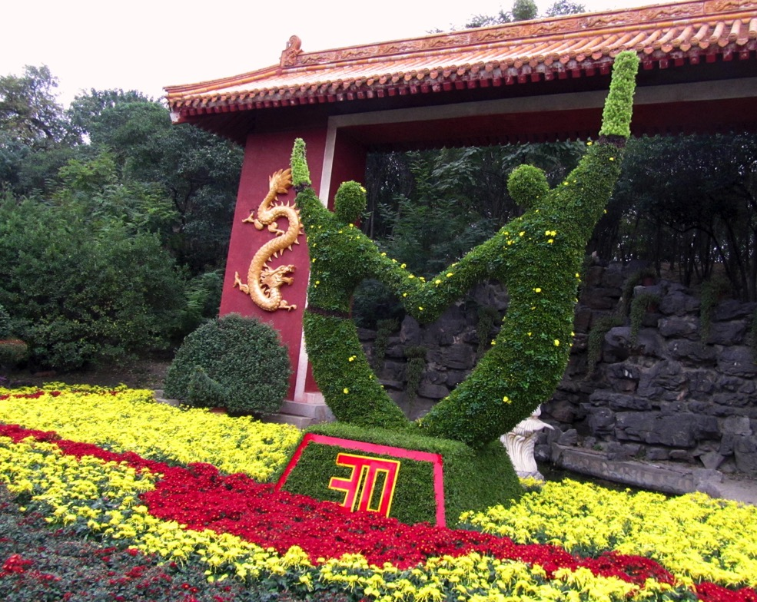

Slide 26
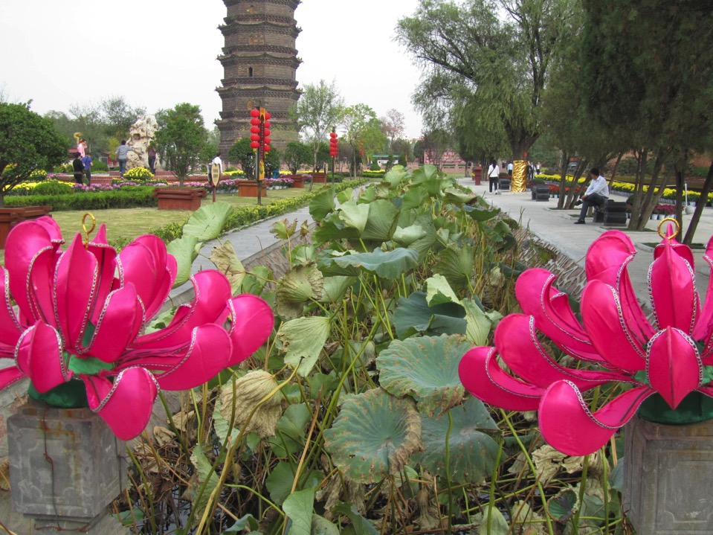

Slide 27
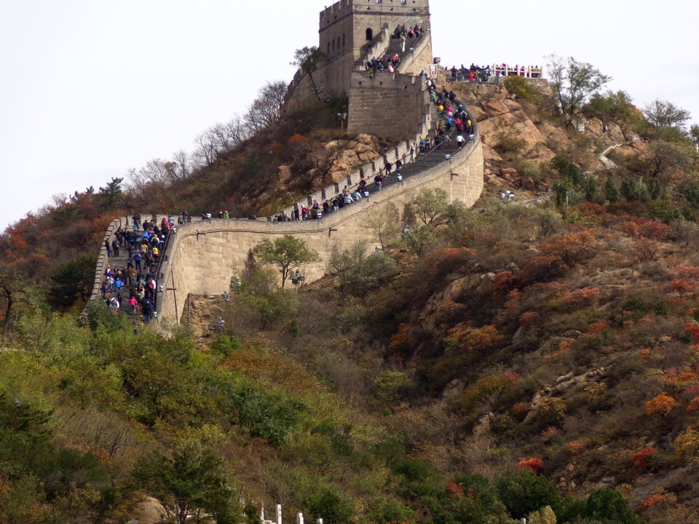

Slide 28
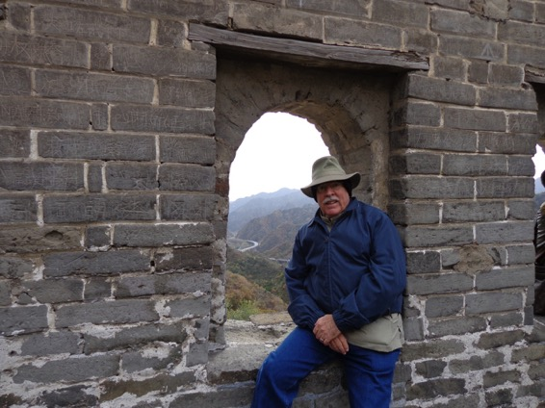
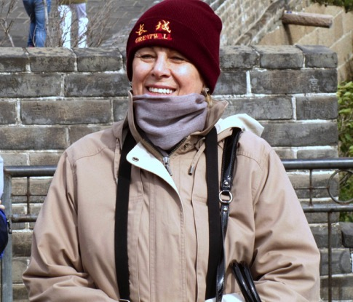
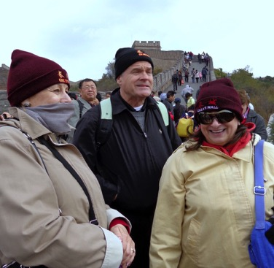
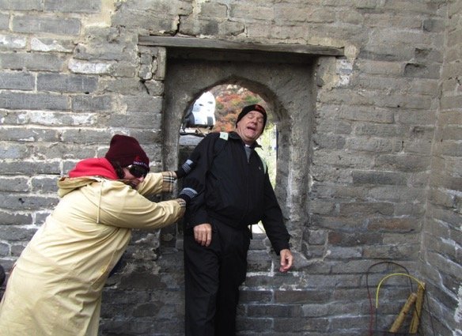

Slide 29
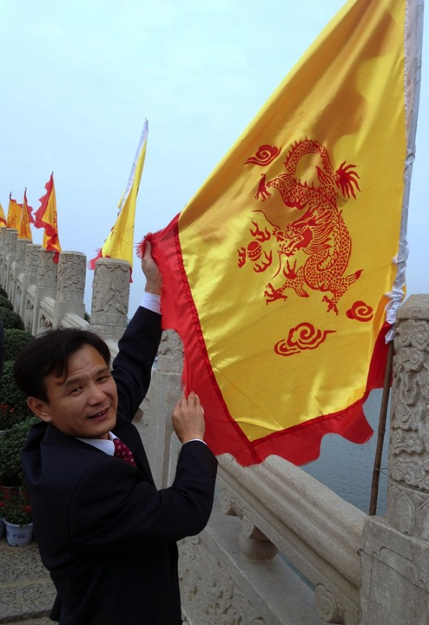
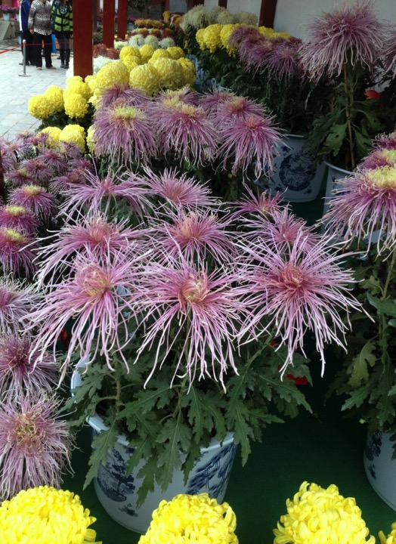
Kaifeng University
October 20, 2012

Slide 30
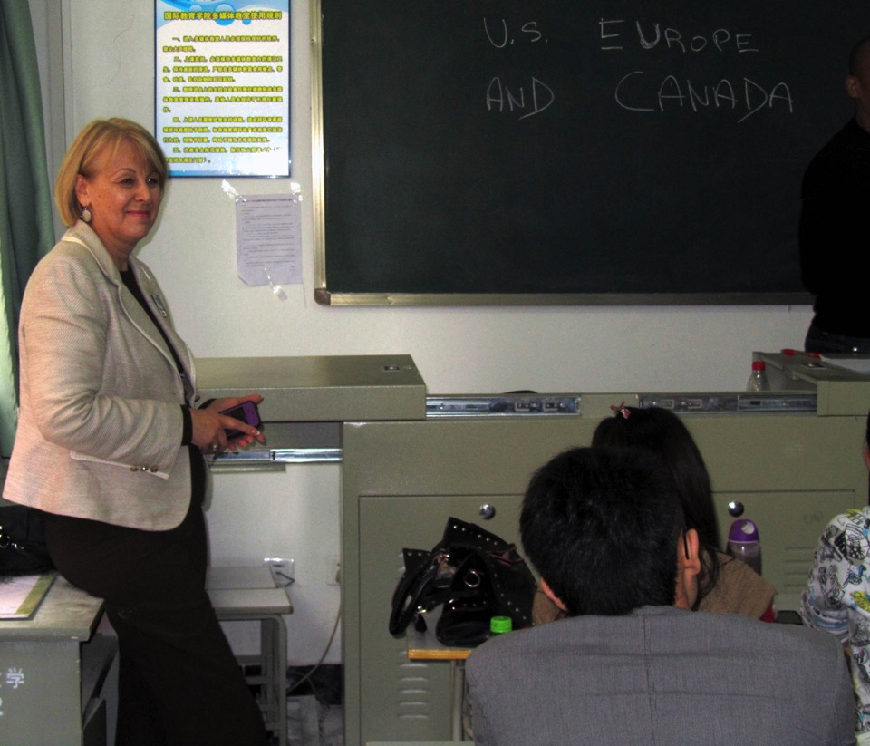
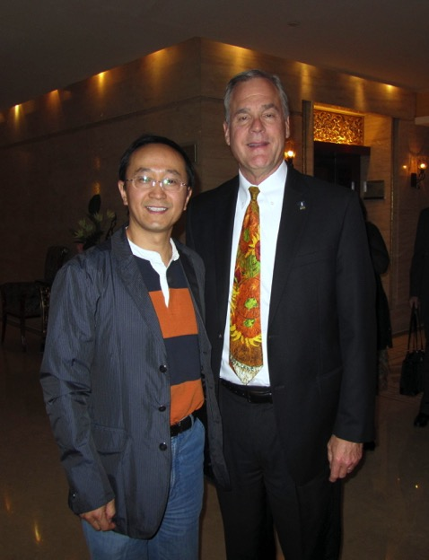
Dr. LI ZHI - DEAN of Business Administration and International Education Colleges and Mr. Marty Miller, Botanica

Slide 31
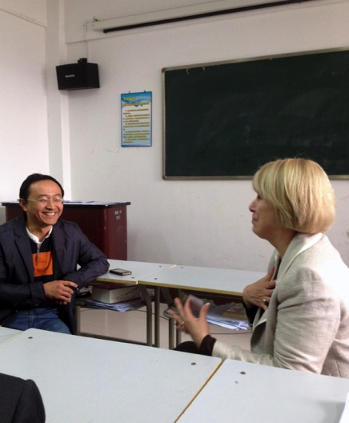
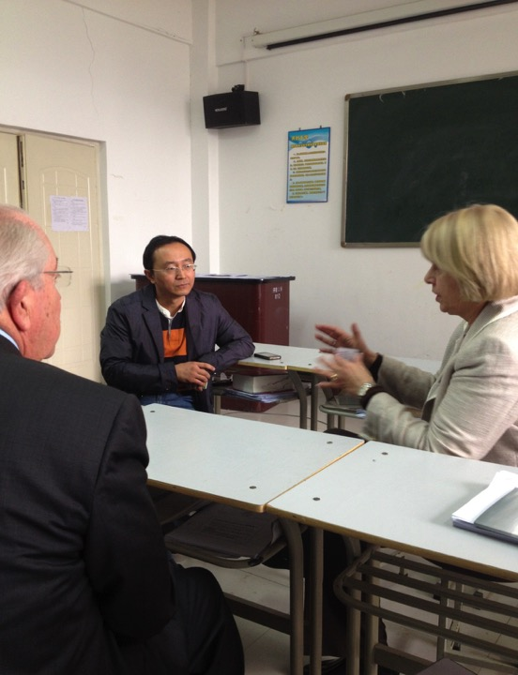
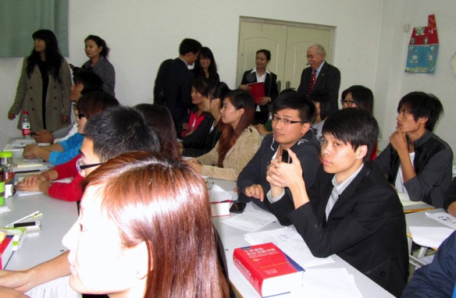

Slide 32
Dr. LI ZHI DEAN of Business Administration College and International Education College
“Dear Dr. Valentina Chappell,
It is nice to hear from you. It's our pleasure to meet the delegation of Wichita Sister Cities. Even through your visit is very short, we have a warm discussion and get to know each other better.
With the help of Kaifeng Foreign and Overseas Affairs Office, I am sure that our cooperation will have a good result in the near future.
Best regards,
LI Zhi
Kaifeng University”

Slide 33
ORLEANS, FRANCE
August 16, 1944 (unofficial)
1974 (through Sister Cities International)
Miss April Leason, 2012 WASC President

Slide 34
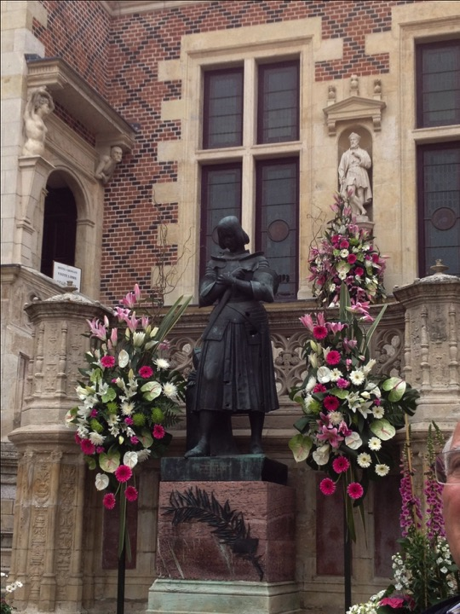
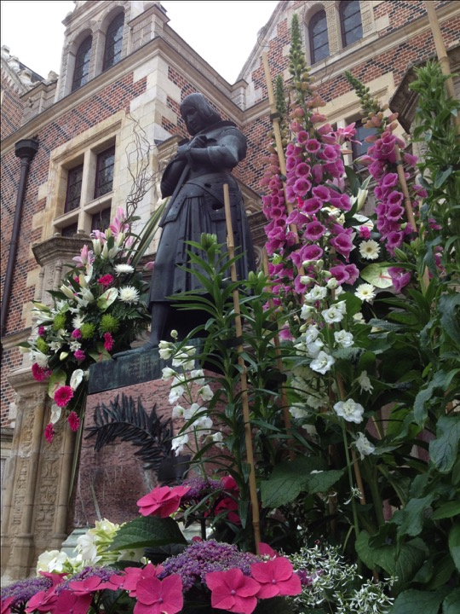
ORLEANS, FRANCE

Slide 35
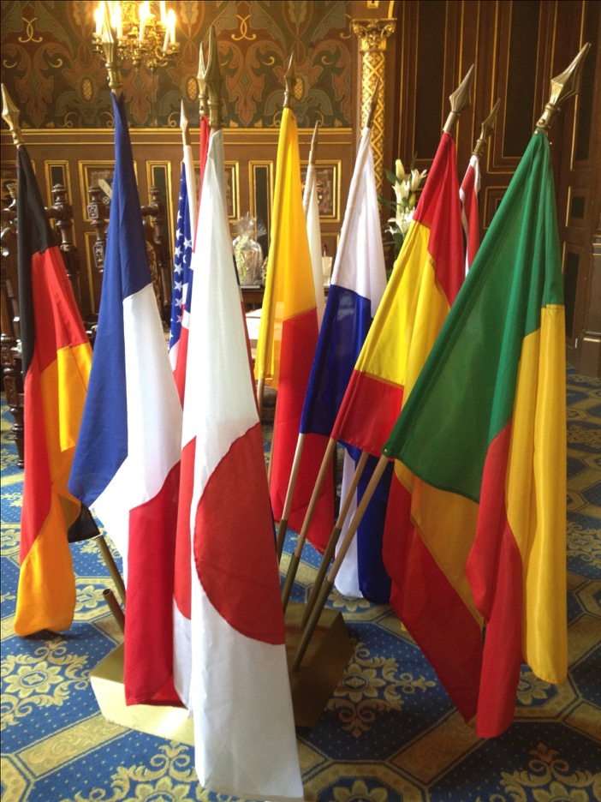

Slide 36
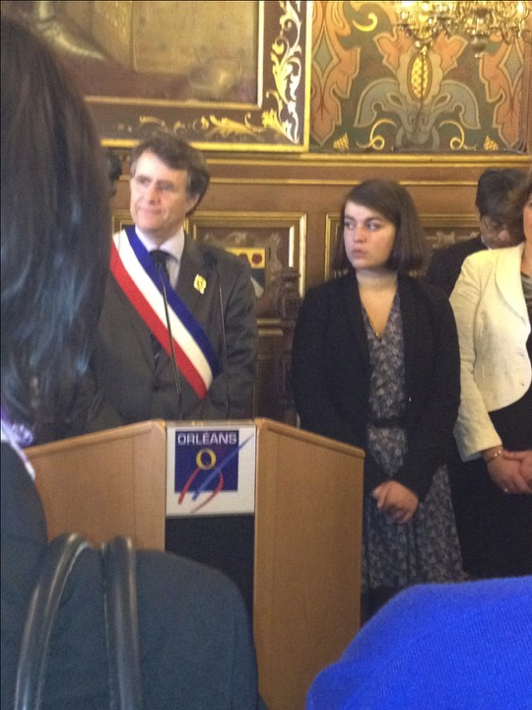

Slide 37
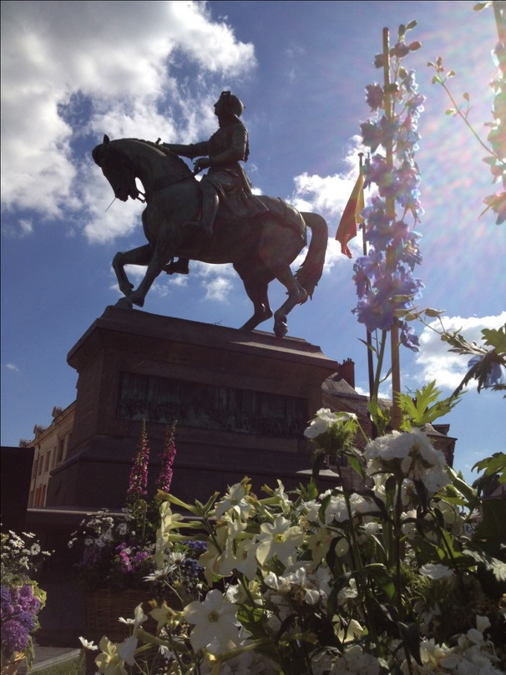

Slide 38
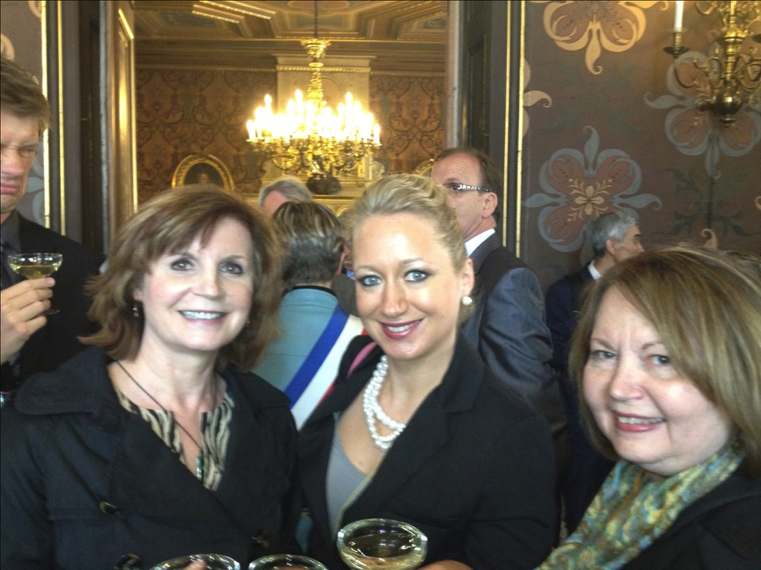

Slide 39
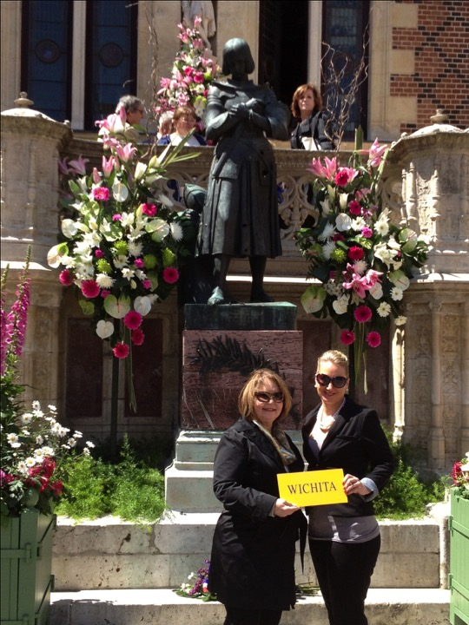

Slide 40
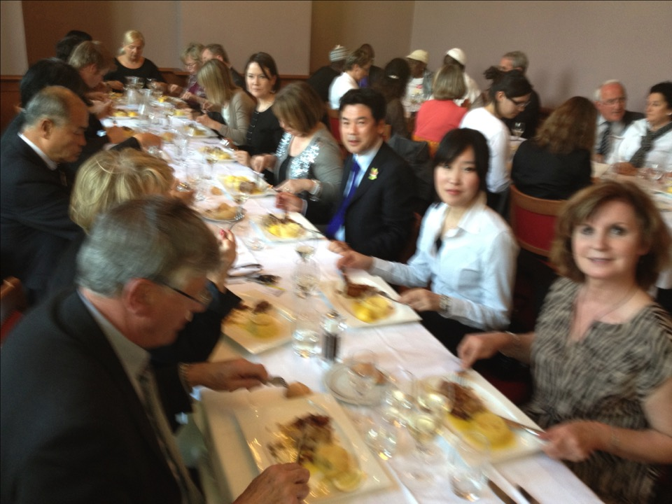

Slide 41
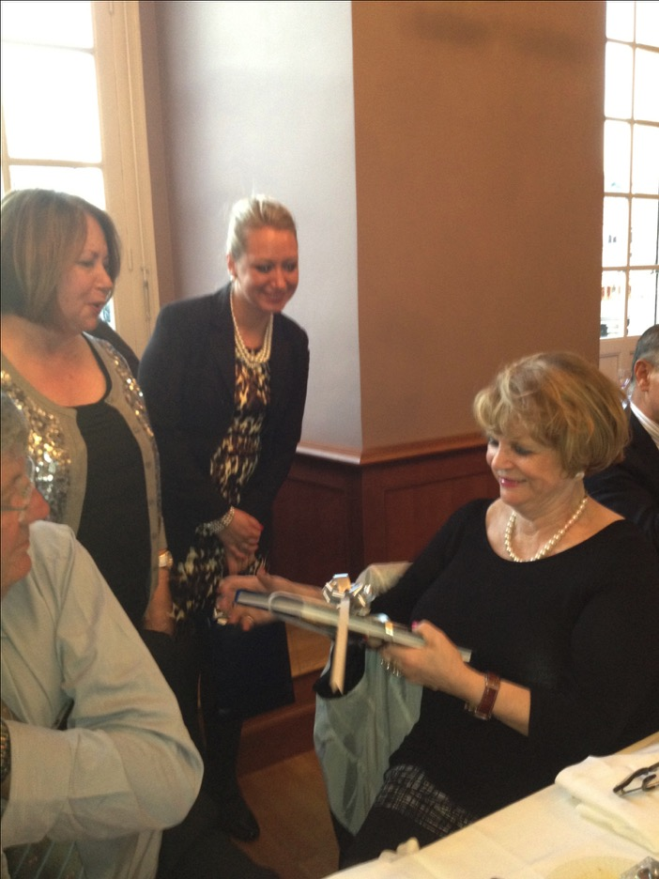

Slide 42
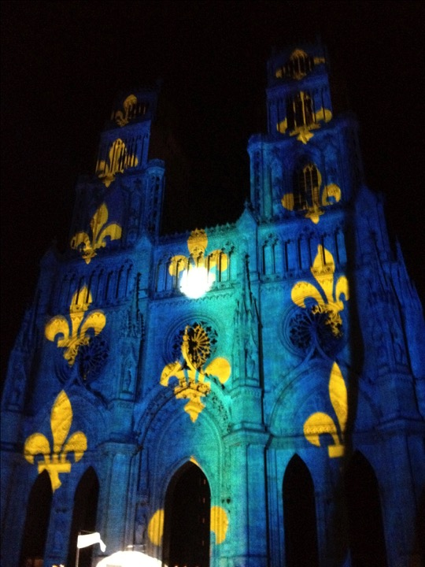

Slide 52
MEXICO
Tlalnepantla, Mexico - October 16, 1973
Cancun, Mexico - November 25, 1975
Dr. Jerry Smartt, Friends University

Slide 70
WASC Board meetings are open to all members
City Council, Conference room, the FOURTH THURSDAY at 5:15 p.m. of each month
CHINA Committee – the THIRD THURSDAY at 6 p.m. at Oh Yaeh China Bistro, 3101 N. Rock Road
FRANCE Committee – the FIRST SATURDAY at 10 a.m. at Watermark’s (basement)
MEXICO Committee - TBD

Slide 71
JOIN US AT
THANK YOU!

