Slide 1
GLOBAL LEARNING CENTER
Meetings: Watermarks Café PO Box 781715 Wichita KS 67278 Incorporated on April 20th 1988 501[C]3 Non-Profit Organization EIN 48-1058052

Slide 2
GLOBAL LEARNING CENTER
MISSION
The mission of the GLC is to provide opportunities for learning about peoples and cultures of the world in order to promote a peaceful future.
PURPOSE
Engage in research, education and service in the area of global learning to involve greater numbers of people of Wichita and the surrounding area in constructive international dialogue; to help visitors from abroad more fully understand Kansans; and to involve large numbers of persons in the discovery of workable solutions to the problems of the globe.

Slide 3
GLOBAL LEARNING CENTER
GOALS
To establish an independent international dialogue and global learning organization;
To serve as a focal point for international education and exchange efforts; and
To become an organization capable of serving persons and groups, including those not now being helped, to gain global knowledge and international understanding.

Slide 4
GLOBAL LEARNING CENTER
BOARD MEETINGS
10:00 AM, 1st Saturday of each month
Watermark Café
MONTHLY EVENTS
August to May
6:00 PM, one Sunday evening each month
Different locations, in 2016 usually dinner at Olive Tree Banquet and Catering, 2949 N Rock Road, Wichita 67226

Slide 5
GLOBAL LEARNING CENTER
BOARD
Executive Steering Committee for 2016:
President: Gretchen Eick
Vice President: Jim Phillips
Treasurer: Holger Meyer with Michael Aumack
Secretary: Emily Schlenker
Publicity and Membership: to be filled
Members: Sue Abdinnour, Ikram Ahmed, Michael Aumack, Dotty Billings, Pat Ciotti, Gretchen Eick, Shayla Johnston, Sarah Johnston, Lakshmi Kambampati, David Kapten, Yonka Krasteva, Jens Kreineth, Holger Meyer, Tom Moore, Leslie Page, Zhanna Pataky, Jim Phillips, Emily Schlenker, and …..

Slide 6
GLOBAL LEARNING CENTER
BOARD
Officers serve two years in a particular role
Officers are elected annually by the board
Members may serve 2 consecutive 3-year terms before being required to take a year off
Ideally, there are 24 members in 3 groups of 8 with 8 members going off and 8 coming on annually

Slide 7
GLOBAL LEARNING CENTER
FOUNDING BOARD 1988
Howard Johnston (President), David Walker (Vice President), Jeanne Johnston (Secretary), Anna Anderson (Treasurer), Stuart Berger, Pat Cameron, CG Chacko, Darold Deterdin, Patricia Ann Hatcher, Ben Henry, Myrliss Hershey, Pat Lehman, Diane Lincoln, Otis Milton, Jim Munson, Sam Myskens, Ken Stewart, Tim Voss

Slide 8
GLOBAL LEARNING CENTER
LOCATIONS
1989 124 S Broadway
1990 435 S Broadway
1995 Office 334 N Topeka; Resource Room Brennan Hall, WSU
1997 529 N Market
2011f Watermark Café & PO Box 781715 Wichita KS 67278
{Mara’s Garage} {Dotty’s Laboratory}

Slide 9
GLOBAL LEARNING CENTER programs in 2015
August: Teaching in Sikkim, Northern India, one of the world’s most diverse places
September: Remembering the 1915 Genocide at Musa Dagi and the Last Armenian Village in Turkey
October: UN Banquet on Human Trafficking
November: Cuba Today with Peter Roman from the City University of New York
December: Islam, a Faith and Way of Life with panel at the Islamic Society of Wichita

Slide 10
Programs for 2016
2016
January 31 Guatemala
February 22nd AFRICA RISING: Positive Developments in Africa
March 8th Japan 5 Years after Fukishima
April 10th The Global Water Crisis
May 1st Sustainable Living and Buddhists in Kansas

Slide 11
Attendance at Programs
Varies; usually 30-45 but in December at the Islamic Society, 250 [the UN Banquet had 96 registered to attend but only 73 attended, meaning we lost money paying for 23 empty places for which food had been prepared].
Publicizing in Eagle (kansas.com), with the Peace and Social Justice Center calendar (contact Janice Bradley [janbrad89@gmail.com]) and KMUW calendars helps.
Share on your Facebook account and send the schedule for the year out to your email list.

Slide 12
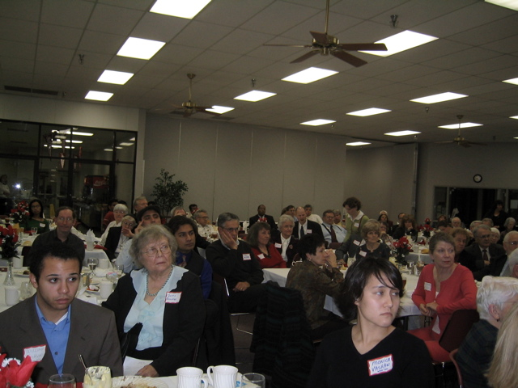
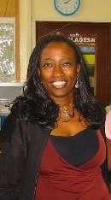
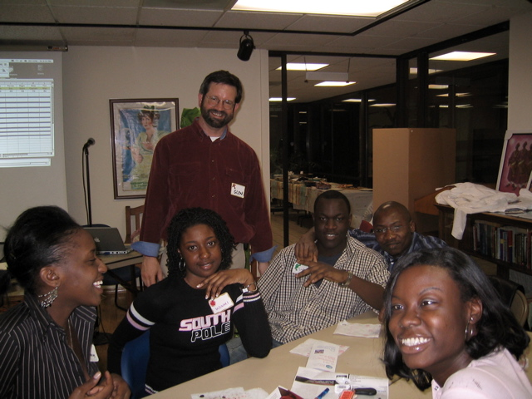
GLOBAL LEARNING CENTER
TRADITIONS
UN Anniversary Banquet in October – celebrating October 24th, 1945----DATE for 2016 is Sat., October 31st--WSU.
January Annual Meeting
Religions of the World
Trivia Nights—none for 2 years—do you want them to return?
Howard & Jeanne Johnston Global Community Citizenship award

Slide 13
GLOBAL LEARNING CENTER
UN ANNIVERSARY BANQUETS
Speakers:
1989 Rev. Sylvia Farmer
1990 Hilda Paqui – UN Development Programs
1991 George Neavoll, Wichita Eagle
1992 David Farnsworth, Political Science, WSU
1993 – no information
1994 Panel: Don Skokan, Janet Nickel, Manfred Menking, CG Chacko
1995 Carol Konek, Chair Womens Studies, WSU
1996 Robert Musil, Physicians for Social Responsibility
1997 – no banquet
1998 Panel: James McKenney WSU PoliSci & CG Chacko Friends PoliSci
1999 Tim Weldon, Newman University
2000 Jonathan Schell, Author & Journalist
2001 Lawrence Korb, Council for Foreign Relations
2002 Joeseph Cirincione, Carnegie Endowment for International Peace
2003 Victor Sidel, Albert Einstein College of Medicine

Slide 14
GLOBAL LEARNING CENTER
UN ANNIVERSARY BANQUETS
Speakers:
2004 Ramu Damudaran, UN Secretariate
2005 Nancee Oku-Bright UN Humanitarian Affairs
2006 Brian Vitunic, UN Central Asia Desk
2007 Kathleen Abdalla, UN Sustainable Development
2008 Donald Lee, UN Millennium Development Goals
2009 Ari Gaitanis, UN Peace Keeping
2010 Liv Tigerstedt, UN Anti-terrorism
2011 Dena Gudaitis, UN World Food Program
2012 Antonie deJong, UN Women’s Rights
2013 Dr. Abraham Joseph
2014 Alex Taukatch, Changing UN Positions
2015 Assistant to the US Attorney for Kansas Tom Beall & Founder of ICTSOS, Jennifer White, on Human Trafficking

Slide 15
Financial Report
Checking Account
Endowment

Slide 16
GLOBAL LEARNING CENTER
Howard & Jeanne Johnston Memorial Fund
Endowment
Ken & Marjorie Stewart
Markham Foundation
Howard Johnston Memorial Fund

Slide 17
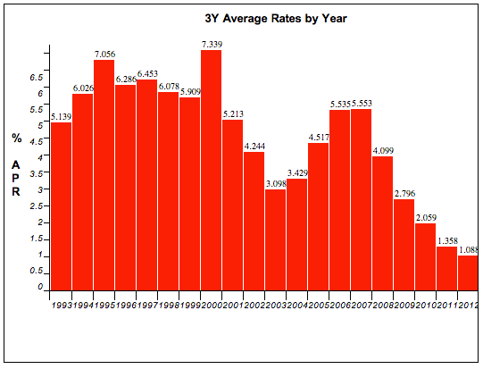
GLOBAL LEARNING CENTER
Endowment

Slide 18
GLOBAL LEARNING CENTER
Howard & Jeanne Johnston Global Community Citizenship
Awardees:
2000 – Howard Johnston, Founding Member
2001 – Al Vargo, Director of Intensive English Program, WSU
2002 – Ken Stewart, Lawyer, Founding Member
2003 – Randy Bush, Director International Education, Butler CCC
2004 – Billy McCray
2005 – Manfred & Susan Menking, Physicians for Social Responsibility
2006 – Dorothy Billings, Anthropology Professor, WSU
2007 – Glyn Rimmington, Professor of Global Learning, WSU
2008 – Balbir & Treva Mathur, Trees for Life
2009 – Vimal Goyle, Physician
2010 – Carolyn Shaw, Chair Political Science, WSU
2011 – Rick McNary, CEO of Numana
2012 – Michael Poage, Pastor, Poet, Activist

Slide 19
Johnston Award Winners Continued
2013 Mohan and Lakshmi Kambampati, committed internationalists, honored teacher and director of the Wichita IndoChina Center
2014 Dr Deema DeSilva, 36 years the director of the Office of Special Programs at WSU including TRIO; Mary Harren, lifelong peace activist; Sister Ann Catherine Burger of the Sisters of St. Joseph and tireless worker for the poor in Hilltop Ministries
2015 Sam Muyskens, former director Interfaith Ministries, current director Global Faith in Action
2016
2017
2018
2019
2020

Slide 20
Election of new board members:
Barbara James, attorney and internationalist with Africa connections and background; active with GLC at its inception
Carl Williams, photographer and activist with the Silver Haired Legislature with experience in fund raising
Mansoor Ali, businessman with his own Ali Foundation who became aware of the GLC at its program in December at the Islamic Society of Wichita
Refika Sarionder, from Turkey, formerly on the board and now a graduate student at WSU
Nominations from the floor?

Slide 21
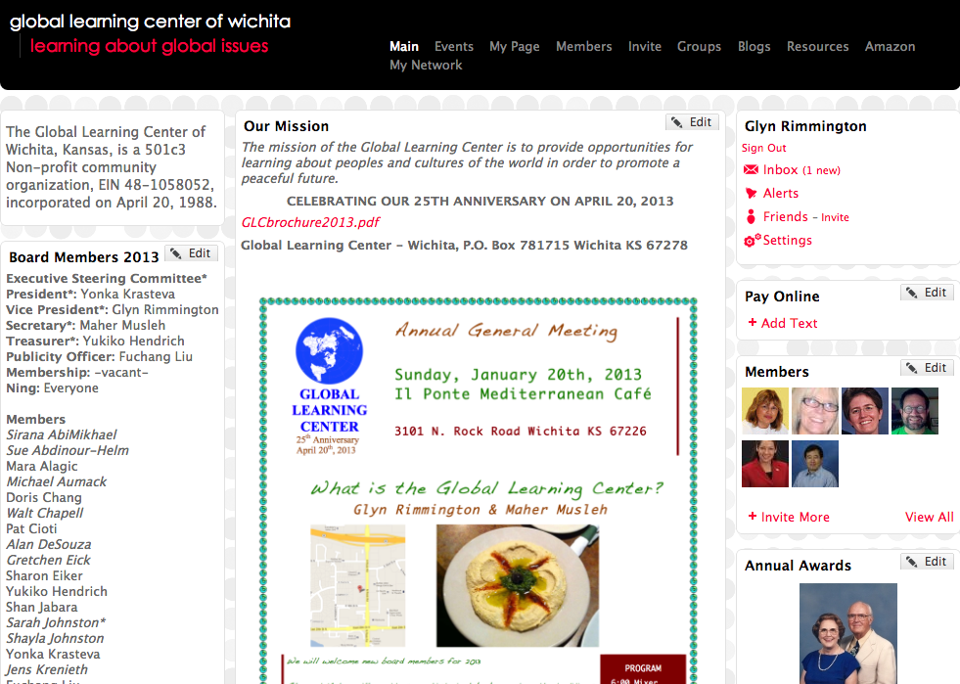
GLOBAL LEARNING CENTER
Internet

Slide 22
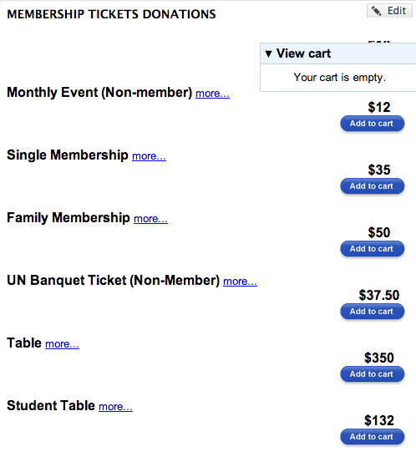
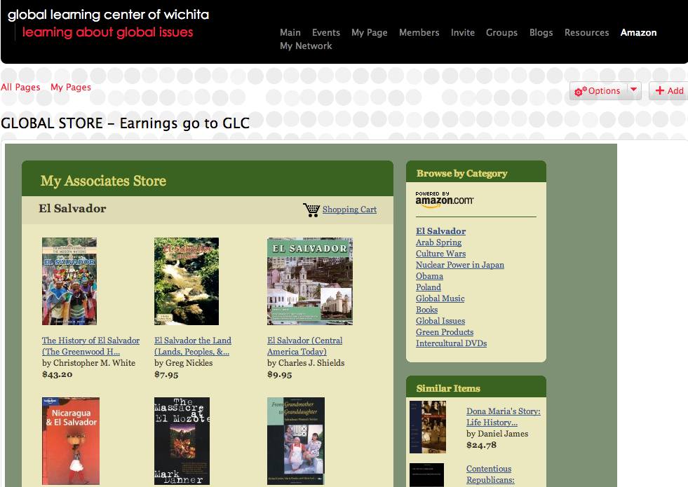
GLOBAL LEARNING CENTER
http://www.globallearningcenterwichita.org
Internet

Slide 23
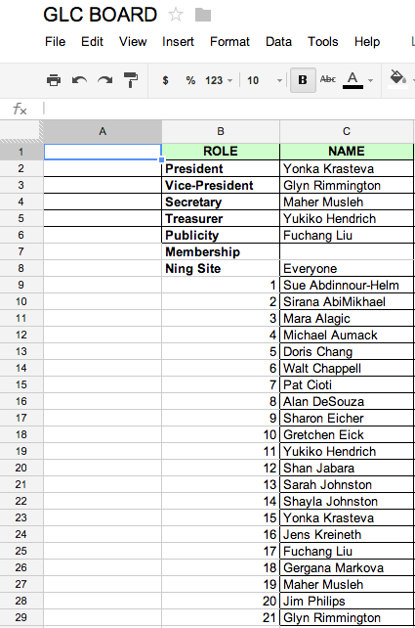
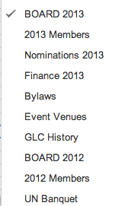
GLOBAL LEARNING CENTER
Internet
http://docs.google.com

Slide 24
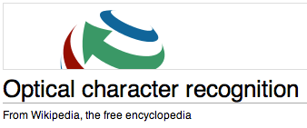
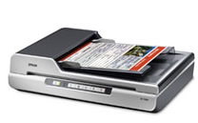
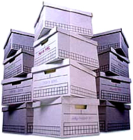
GLOBAL LEARNING CENTER
Historical Research
SEARCHABLE PDF FILES
Shared on Googledocs
Articles of Incorporation
Bylaws**
Newsletters / Flyers
Minutes
Correspondence
Historical papers at home of Sarah & Bill Johnston, El Dorado, Ks.

Slide 25
GLOBAL LEARNING CENTER
QUESTIONS?

Slide 26
GLOBAL LEARNING CENTER
FOUNDING MEMBERS:
Honored:
2012 – Pat Cameron, Myrliss Hershey, CG Chacko, Sam Myskens, (Anna Anderson)

