Slide 1
Global Learning Center, INC.
2016 Annual Report
Dr. Gretchen Eick, Outgoing President
501c3 Non-profit Organization EIN 48-1058052 Incorporated April 20th 1988
www.globallearningcenterwichita.org

Slide 2
2016
Mission -- The mission of the Global Learning Center is to provide opportunities for learning about peoples and cultures of the world in order to promote a peaceful future.
Programs -- Programs are planned in May for the year and board members take responsibility for locating speakers and planning specific programs.
In 2016, we offered Wichita 10 monthly educational events preceded by a meal, hosting most of them at the Olive Tree Banquet Hall/Two Olives (formerly Piccadilly) on Sunday evenings.

Slide 3
2016 Programs
January 31st GLC Annual Meeting and Service Learning in Guatemala—Dr. Sonja Bontrager
February 21st Africa Rising - Positive Developments in Africa-- Dr. Chinyere Okafor and Ebrima Mboob
March 6th Japan 5 Years after Fukushima-- Yukiko Hendrich and Marie Yoshimizu

Slide 4
2016 Programs
April 10th The Global Water Crisis-- Walt Chappell and Jim Phillips
May 1st, 2016 Sustainable Living and Buddists in Kansas—Tom Moore, organizer, held at Phap Hoa Temple, 4706 N. Arkansas Street
Aug. 28th Understanding Islam-- Manzoor Ali and Hussam Madi of the Islamic Society of Wichita

Slide 5
2016 Programs
September 25th Eco Justice and Climate Change--
October 29 [Saturday] UN Banquet on the WSU Campus, Rhatigan Student Center Ballroom: Dr. Lisa Aubrey, Roots and Reconnection: The International Decade for People of African Descent
November 13th International Trade Agreements, TPP, TTIP, etc.—organized by Wakeelah Martinez, Ted J. Vlamis, Vice President at Pioneer Balloon Company, and WSU Professor Dr. Michael Hall
December 4th Silencing Dissent: Rising Authoritarianism, Gezi Protests, and the State of Civil Society in Turkey—Dr. Jens Kreinath

Slide 6
GLC Board at UN Banquet

Slide 7
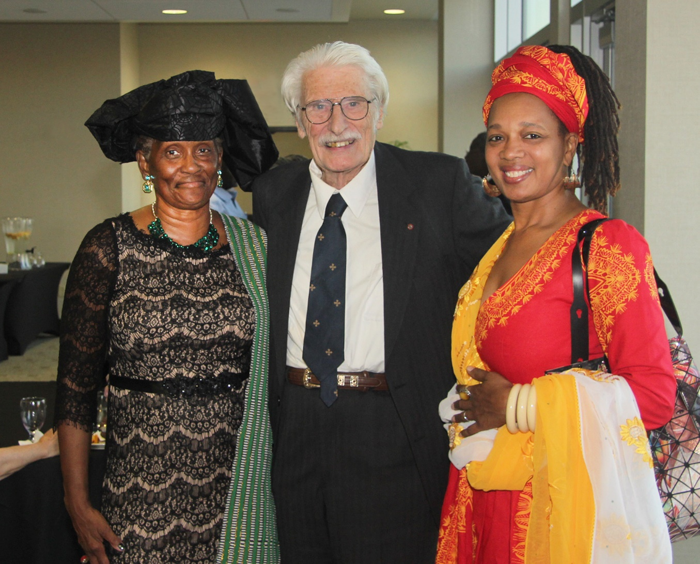
Jens Kreinath, Dotty Billings, Schuyler Jones, Carla Burns, Wakeelah Martinez
Barbara James,
Schuyler Jones
Speaker Dr. Lisa Aubrey

Slide 8
Programs other than the October UN Banquet are held on Sunday evenings from 6-8:30, usually at The Olive Tree/Two Olives, 2949 N Rock Road. Meals cost $12 for members, $14 for non-members, $10 for students and the program is free for anyone interested in attending without eating. Meals are generally coordinated to match the region addressed in the program. Advance notice and payment for meals through the website www.globallearningcenterwichita.org enables us to have enough food.

Slide 9
Memberships help this all-volunteer organization stay in the black. Memberships are $35 for individuals and $50 for families and are considered charitable donations by the IRS. Lifetime memberships are $500.

Slide 10
Treasurer’s Report
We began the year with $5,657.10 in our checking account and ended with $5,182.66. Total expenses of $7,335.43 for catering events, reimbursement of speaker expenses, subsidy of student tickets at the UN banquet, and other operating expenses (e.g. website, globe award, etc.) were larger than total income from payments for events, memberships, and donations of $6,859.73. The year-end balance is $475.70 below the beginning balance.
The GLC also received in-kind donations from some of the board members in support of some of the events, for example sushi for the event on Japan and wine for the speaker and honoree reception at the UN Banquet. Thank you.
Our endowment is at $29,569.54, a negligible increase over the year due to very low CD interest rates. Holger Meyer

Slide 11
Endowment to support student participation in the UN Banquet: Thanks to many who have believed in the GLC’s mission over the years, we have an endowment fund that was set up to enable students to attend the UN Banquet while paying only the $10 student rate for that meal.

Slide 12
GLOBAL LEARNING CENTER
UN ANNIVERSARY BANQUETS
Speakers:
1989 Rev. Sylvia Farmer
1990 Hilda Paqui – UN Development Programs
1991 George Neavoll, Wichita Eagle
1992 David Farnsworth, Political Science, WSU
1993 – no information
1994 Panel: Don Skokan, Janet Nickel, Manfred Menking, CG Chacko
1995 Carol Konek, Chair Womens Studies, WSU
1996 Robert Musil, Physicians for Social Responsibility
1997 – no banquet
1998 Panel: James McKenney WSU PoliSci & CG Chacko Friends PoliSci
1999 Tim Weldon, Newman University
2000 Jonathan Schell, Author & Journalist
2001 Lawrence Korb, Council for Foreign Relations
2002 Joeseph Cirincione, Carnegie Endowment for International Peace
2003 Victor Sidel, Albert Einstein College of Medicine

Slide 13
GLOBAL LEARNING CENTER
UN ANNIVERSARY BANQUETS
Speakers:
2004 Ramu Damudaran, UN Secretariate
2005 Nancee Oku-Bright UN Humanitarian Affairs
2006 Brian Vitunic, UN Central Asia Desk
2007 Kathleen Abdalla, UN Sustainable Development
2008 Donald Lee, UN Millennium Development Goals
2009 Ari Gaitanis, UN Peace Keeping
2010 Liv Tigerstedt, UN Anti-terrorism
2011 Dena Gudaitis, UN World Food Program
2012 Antonie deJong, UN Women’s Rights
2013 Dr. Abraham Joseph
2014 Alex Taukatch, Changing UN Positions
2015 Assistant to the US Attorney for Kansas Tom Beall & Founder of ICTSOS, Jennifer White, on Human Trafficking
2016 Dr. Lisa Aubrey, Roots and Reconnection: UN The International Decade for People of African Descent

Slide 14
Howard and Jeanne Johnston Global Citizen Award
Awarded to Dr. Schuyler Jones, acclaimed anthropologist from Wichita, received the Global Citizen Award this year and was presented with an engraved globe of the world by the descendants of Howard and Jeanne Johnston for whom the award is named.

Slide 15
The Johnston Family

Slide 16
2017 Programs
January 22th Annual Board Meeting and Vietnam Today, 24 years after US recognition—Marie Gillespie, Khanh Nyugen, Yonka Krasteva
February 19th Refugee crisis and European Union—Dr. Yonka Krasteva
March 12th Rights of Indigenous Peoples—Dr. Roxanne Dunbar-Ortiz, internationally known expert and author of Roots of Resistance, An Indigenous People’s History of the United States, Blood on the Border, Red Dirt, and Outlaw Woman: a Memoir of the War Years, 1960-1975. Her website is http://www.reddirtsite.com/. This event will be held at the Metroplex, 29th and Oliver

Slide 17
Again!
March 12th Rights of Indigenous Peoples—Dr. Roxanne Dunbar-Ortiz, internationally known expert and author of Roots of Resistance, An Indigenous People’s History of the United States, Blood on the Border, Red Dirt, and Outlaw Woman: a Memoir of the War Years, 1960-1975. Her website is http://www.reddirtsite.com/. This event will be held at the Metroplex, 29th and Oliver

Slide 18
2017 Programs
Apr. 9th Educating resettler/foreign born students in US public schools—The grandson of GLC’s founders, Howard and Jeanne Johnston, will be coming in from Denver to be our presenter.
May 7th Saudi Arabia—culture, politics, Shia-Sunni, and U.S. policy—a panel of students from Saudi Arabia moderated by Michael Poage.

Slide 19
Oct. 21, 2017 UN Banquet
The UN Banquet has been held on the WSU campus on a Saturday rather than Sunday evening for 2015 and 2016 and is scheduled for Oct. 21 for 2017 continuing at the Rhatigan Campus Activities Center of Wichita State University. Please hold the date.

Slide 20
Board for 2016 –each member may serve 2 3-year terms, then must take a break
President Gretchen Eick eick@friends.edu
serving her second and final year as president and second 3 year term on the board (2013-2019)
Vice President Jim Phillips jamesphillips21346@gmail.com
moving into the Presidency and his second 3 year term on the board (2013-2019)
Secretary Emily Schlenker eschlenker@cox.net serving her third year on the board (2015-2021)
Treasurer Holger Meyer holgerme@gmail.com serving his second term on the board (2013-19)

Slide 21
2016 Board * = UN Banquet Committee
Publicity and Media Carl Williams carl@att.net serving his second year on the board (2016-22)
Michael Aumack michaelaumack@gmail.com serving his second term on the board (2013-19)
* Barbara L. James attyjames@aol.com resigning from the board after her first year (2016-17)
David Kapten dkapten@yahoo.com serving his third year on the board (2015-21)
Dotty Billings dorothy.billings@wichita serving his second term on the board (2013-19)
Howard Crise hcrise@gmail.com serving his second term on the board (2013-19)

Slide 22
Board 2016
Ikram Ahmed prof.ike@gmail.com resigning after serving since 2013.
Jens Kreinath jens.kreinath@gmail.com serving his second term and fifth year on the board (2012-18)
Lakshmi Kambampati guru1923@gmail.com serving her third year (in Peace Corps in Liberia) (2015-21)
Leslie Page lefpage@yahoo.com serving her third year on the board (2015-21)
Manzoor Ali manzoor@ali-foundation.org serving his second year on the board (2016-22)
Mary Harren maryharren@live.com serving her second year on the board (2016-22)

Slide 23
Board 2016
Michael Aumack michaelaumack@gmail.com serving his fourth year on the board, 2nd term (2013-19)
Pat Ciotti plci48@hotmail.com serving her fourth year on the board, 2nd term (2013-19)
Refika Sarionder rsarionder@gmail.com serving her second year on the board (2016-22)
* Sarah Johnston sarahj3@cox.net serving her fourth year on the board (2013-19)
Tom Moore temoore98@hotmail.com serving his third year on the board (2015-21)
Zhana Pataky ruskie9@cox.net serving her fourth year on the board 2nd term (2013-19)
*Wakeelah Martinez wakeecomm@gmail.com serving her second year on the board (2016-22)
Yonka Krasteva ikrasteva@butlercc.edu leaving the board after serving two terms (2010-17)

Slide 24
The board meets the first Saturday of each month other than July at Watermark Books and Cafe. In May or June a longer meeting in a board member’s home serves as our planning retreat to set the schedule of programs for the year. For the past two years GLC programs for the academic year have been printed and circulated beginning in August/September. Holding events at a set place—The Olive Tree Banquet and Catering for most events and WSU for the October UN Banquet—has simplified our planning and we are grateful to these venues. Also, adding Carl Williams as our board member responsible for publicity and media has made our events more visible. Thank you, Carl!

